Slide 1
LLM-Driven Adaptive Authentication and Access Control in Zero Trust Systems Using Blockchain
Submitted in the partial fulfillment for the award of the degree of
BACHELOR OF ENGINEERING
IN
Computer Science Engineering
Specialization in Information Security (IBM)
Submitted by:
Parth Kansal - 23BIS70035
Anshul Sharma - 23BIS70073
Vireshwar Singh Tomar - 23BIS70081
Under the Supervision of:
Ms. Sidrah Fayaz Wani
Department of AIT-CSE
DISCOVER . LEARN . EMPOWER

Slide 2
Table Of Content
Project Planning and Task Definition
Problem Statement
Literature Review / Background Study
Methodology & Technical Approach
Results Achieved So Far

Slide 3
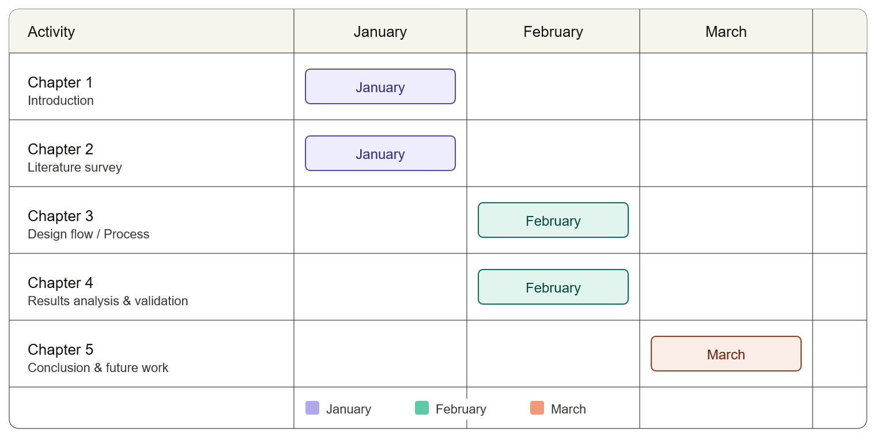
Project Planning and Task Definition
Project Duration: January 2026 to April 2026
Chapter 1: Introduction to the Problem
Chapter 2: Literature Survey
Chapter 3: Design Flow/Process
Chapter 4: Result Analysis And Validation
Chapter 5: Conclusion and Future Work

Slide 4
Task Definition
Chapter 1: Introduction to the Problem
In this phase we have identified the problem on which we have to work and found it as a major issue during the growing era of technology where data is crucial. As we need to manage the data linked to our systems as we rely mostly on our digital systems. So we need to manage the access of our data.
In current situation Identity and Access Management systems often treat all users as same way, applying identical authentication requirements regardless of the how much the actual risk is involved.
As a result, there is a clear need for an access control system that is intelligent, adaptive, and secure

Slide 5
Task Definition
Chapter 2: Literature Survey
Existing Systems: Static Authentication Mechanisms, Rule-Based Authorization Models, Centralized Identity Storage, Limited Intelligence and Automation, Uniform Security Enforcement and Manual Access Approval Workflow.
Key Research: Wiefling et al. (2022) – Large-scale dataset ,RLAuth (2023) – 92.6% accuracy and F-RBA (2024) – Privacy using federated learning.
Behavioral and continuous authentication (Baig & Eskeland, 2021) use biometrics and sensors to verify users throughout sessions, though they raise privacy concerns.
Human-in-the-loop approaches are emerging, where critical access decisions involve stakeholders.
Although no standard architecture exists, combining AI, blockchain, and human validation shows strong potential for future systems.

Slide 6
Task Definition
Chapter 3: Design Flow/Process
Machine Learning-Based Risk Scoring
Design Constraints
Alternative Designs
Design Selection
In this phase we will design the model for our proposed work and try out different design for the optimal design selection.

Slide 7
Task Definition
Chapter 4: Result Analysis And Validation
In this phase we will analyse the result of the our design which we will choose from the different design. We will check different meassures in our proposed method such as:
Overall System Workflow
Key Architectural Components
Core Components of the System
Design Features and Advantages
Testing and Validation

Slide 8
Task Definition
Chapter 5: Conclusion and Future Work
In this phase we will conclude all the work done by the team on the chosen design of the system and deliver the idea. And hope in future such intelligent system will play a major role in safe gaurding our data and offering a better Identity and access system.

Slide 9
Problem Statement
Currently Identity and Access Management systems often treat all users as same way, applying identical authentication requirements regardless of the how much the actual risk is involved. This approach either weakens the security or creates an unnecessary friction for users. Also, the process of providing or revoking access to sensitive information is mostly manual, time-consuming, or lacks proper transparency and accountability.

Slide 10
Literature Review / Background Study
Adaptive, AI-driven authentication is increasingly important for securing sensitive data. Recent research focuses on Risk-Based Authentication (RBA), which evaluates user behavior and context to generate a dynamic risk score.
Picard & Pierre (2023) proposed RLAuth, a reinforcement learning-based system achieving 92.6% accuracy. Fereidouni et al. (2024) introduced federated RBA, improving privacy by training models locally on devices. These works show a shift toward ML-driven adaptive authentication.
Behavioral and continuous authentication (Baig & Eskeland, 2021) use biometrics and sensors to verify users throughout sessions, though they raise privacy concerns.
Blockchain-based systems enhance security through immutability and decentralization. Hu et al. (2023) used smart contracts for controlled access and audit logs. Yaqub et al. (2024) applied blockchain for secure healthcare data sharing. Tawfik et al. (2025) improved performance using Hyperledger-based framework

Slide 11
Results Achieved So Far
We have understood the concepts which were introduced earlier and differentiated all the concepts.
We have read different research papers and concluded their flaws and benefits.
We started to summarize the different technologies used in the earlier system and decided to combine all the technologies together to create a optimized sollution for the arrised problem.

